Slide 1
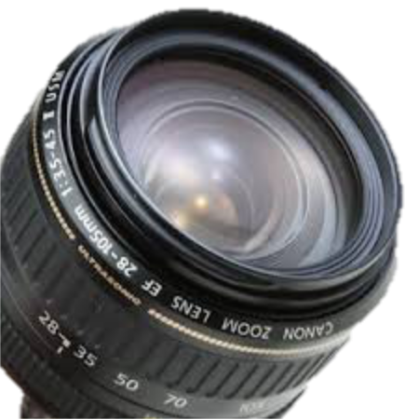
Presented By: Sandy Marie Romo and Alexander Mena
Region 19 CAP Cohort 6

Slide 2
Sometimes we see only want to see…
What is Solution-Focused Based Therapy?

